Slide 1
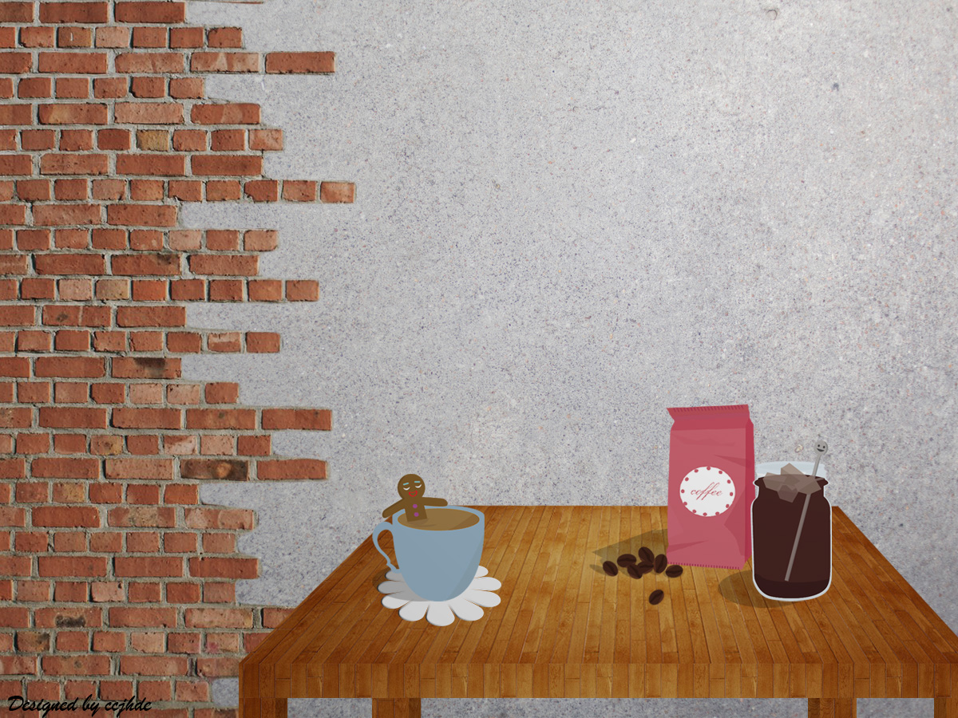

COFFE TIME
HOW TO MAKE
AMERICANO
Sohee Lim, Eunjin Jang

Slide 2
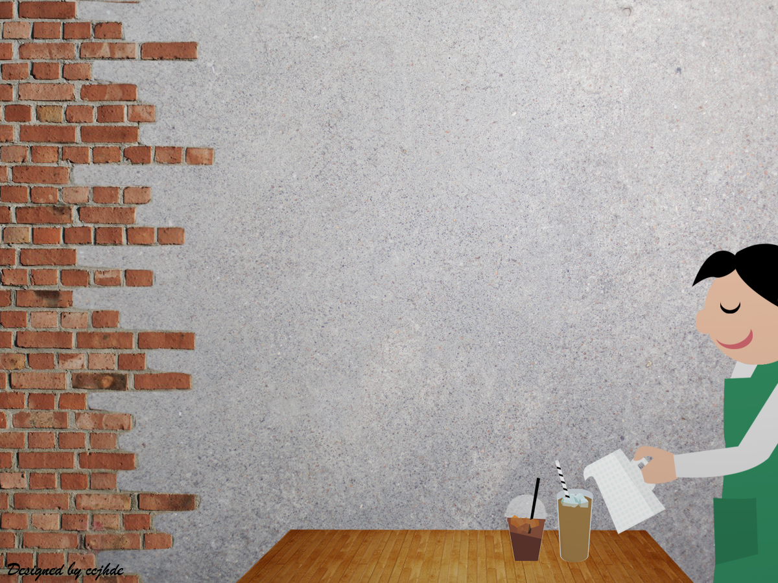

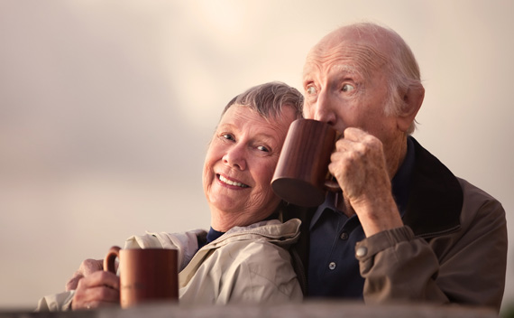
Intro : Drinking Coffee
Coffee is important in our life
Drinking coffee with friends !

Slide 3
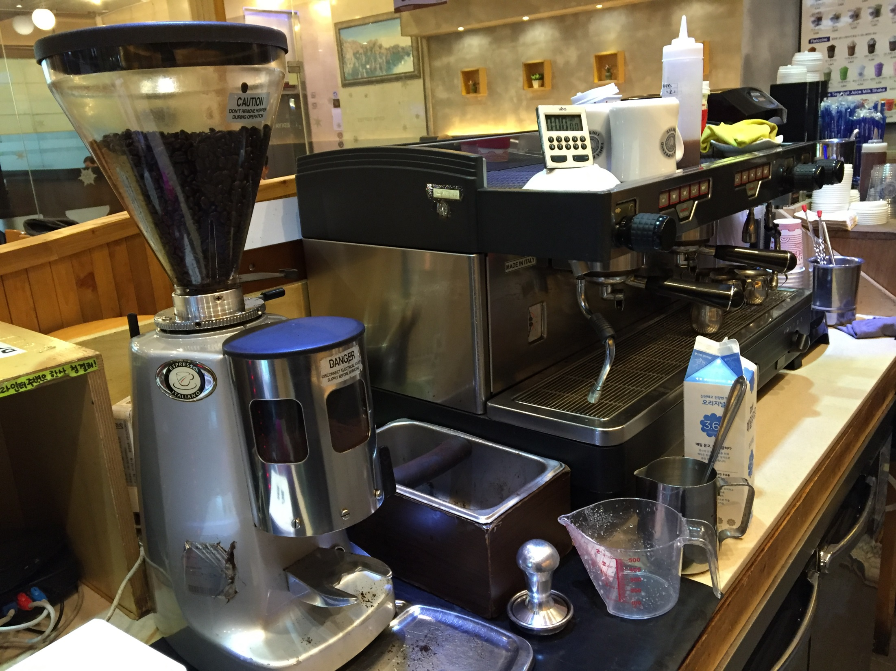
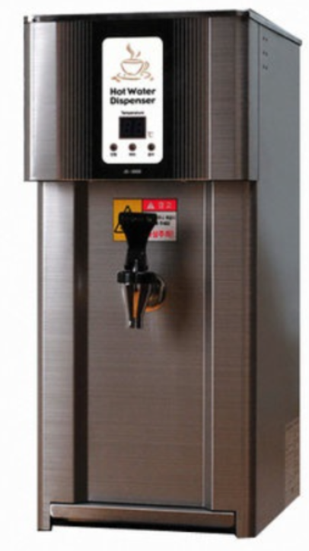
Step 1 : you will NEED
Coffee bean
Grinder
Handle
Espresso machine
Water
Water heater
Tamper

Slide 4
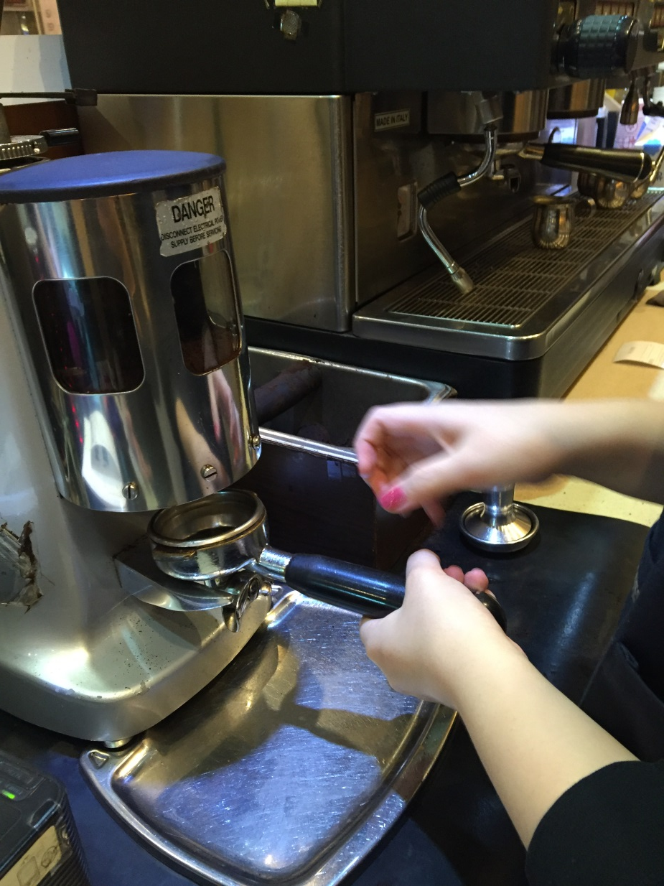
Step 2 : Add the Coffee
Grab the handle
put it under the coffee grinder
Grab
Put

Slide 5
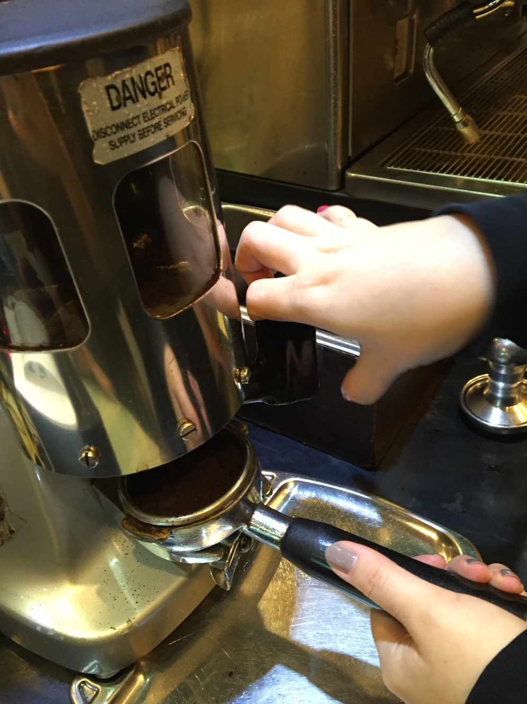
Step 2 : Add the Coffee
Fill the handle with a suitable
amount of coffee powder
Fill

Slide 6
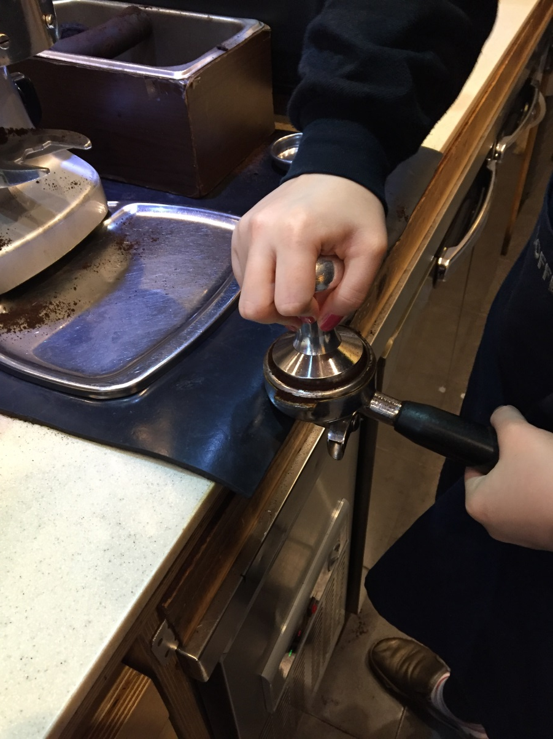
Step 2 : Add the Coffee
Compact
Use the tamper
provided to compact the coffee
water doesn't flow through it too fast.

Slide 7
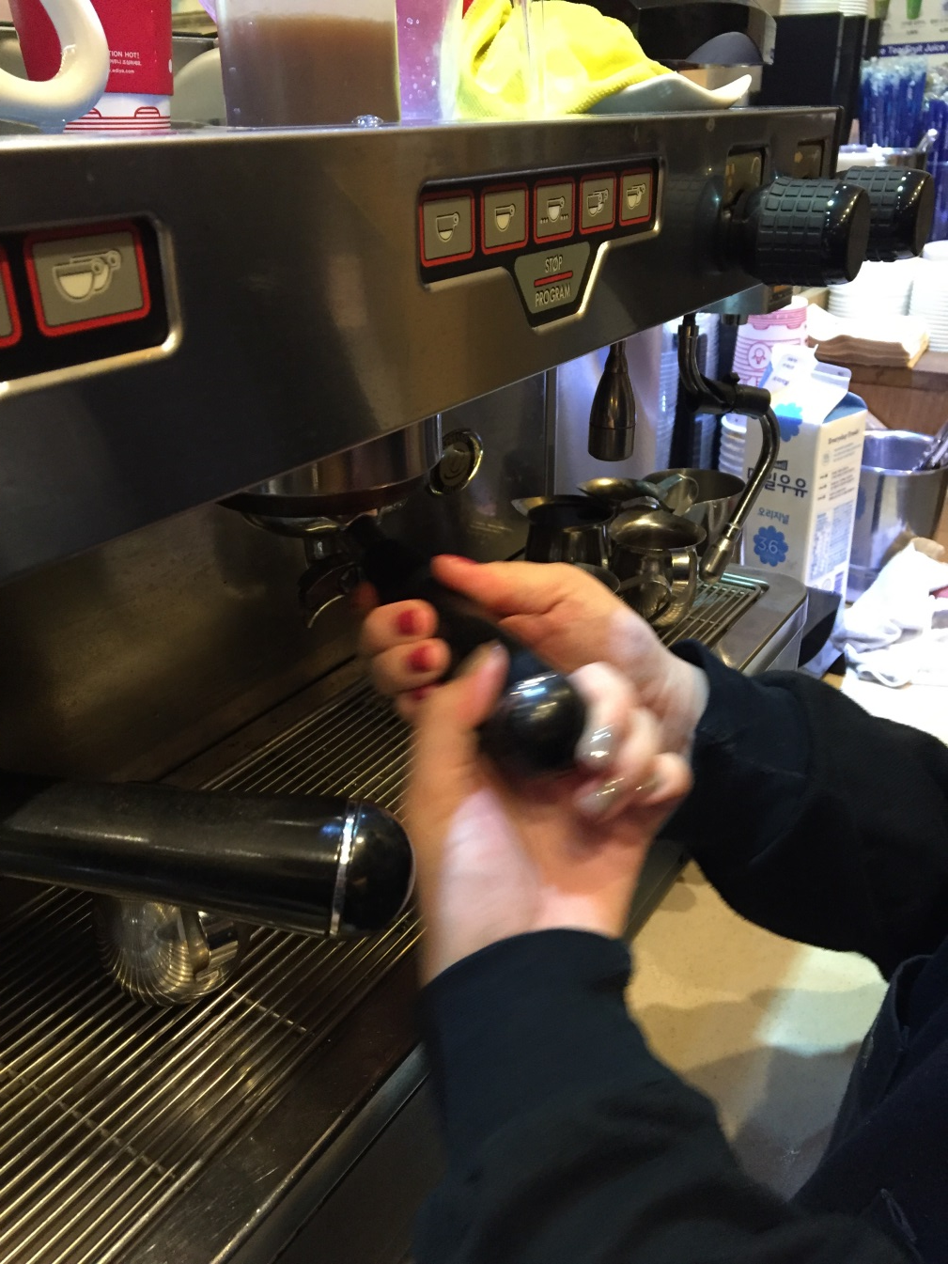
Step 3 : Filter
Lock the group handle
into the machine
Lock

Slide 8
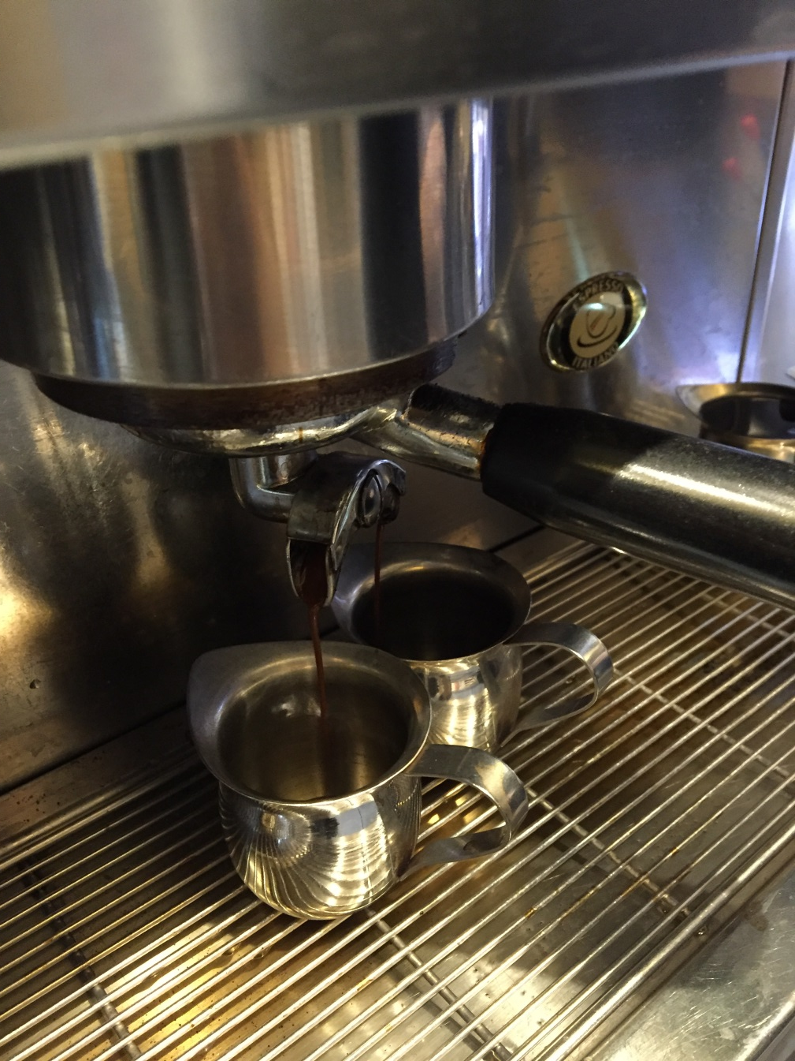
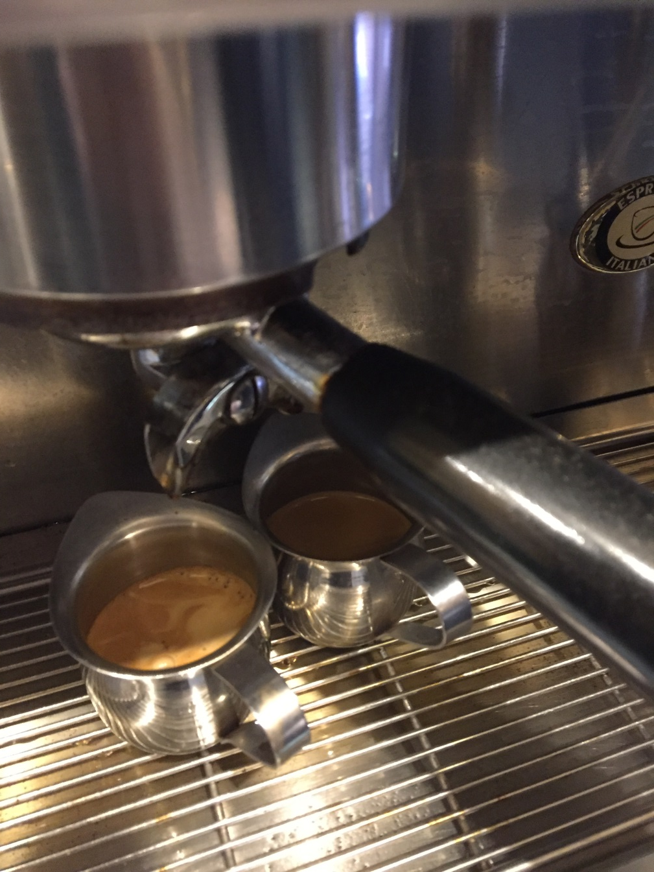
Step 3 : Filter
put a coffee cup underneath
Turn on the dosage button

Slide 9
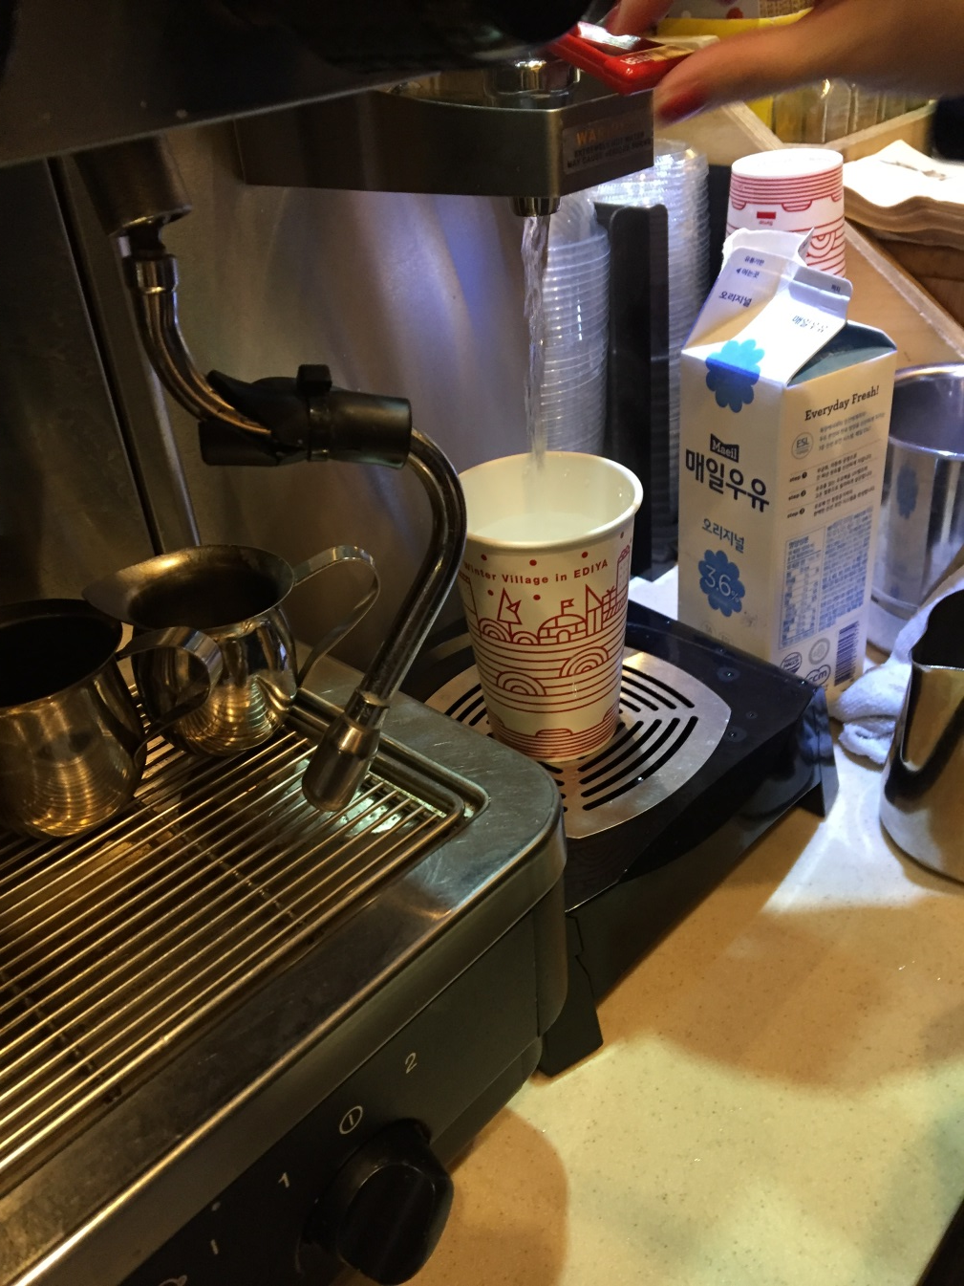
Step 4 : Heat the Water
fill a coffee cup with hot water
Fill

Slide 10
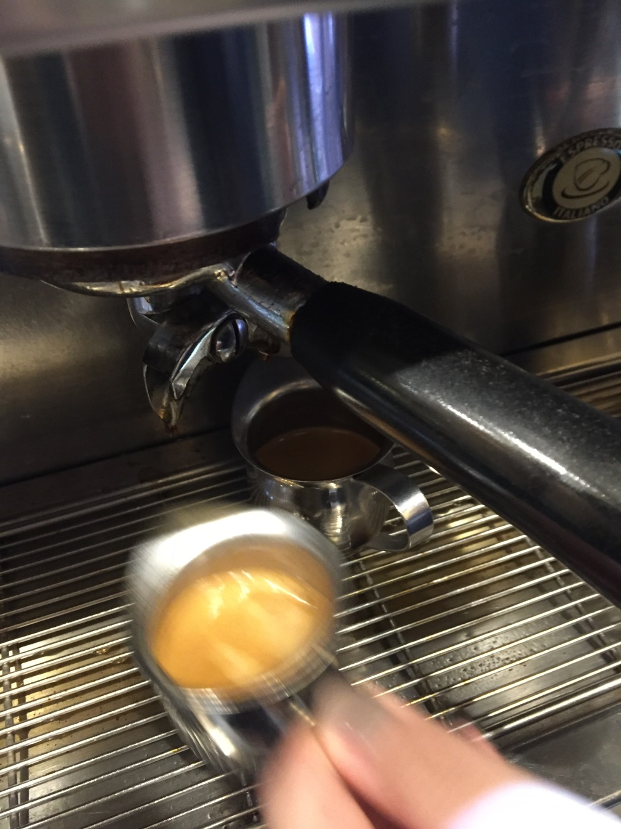
Step 4 : Heat the Water
put a shot of espresso
into the cup
Quickly!

Slide 11
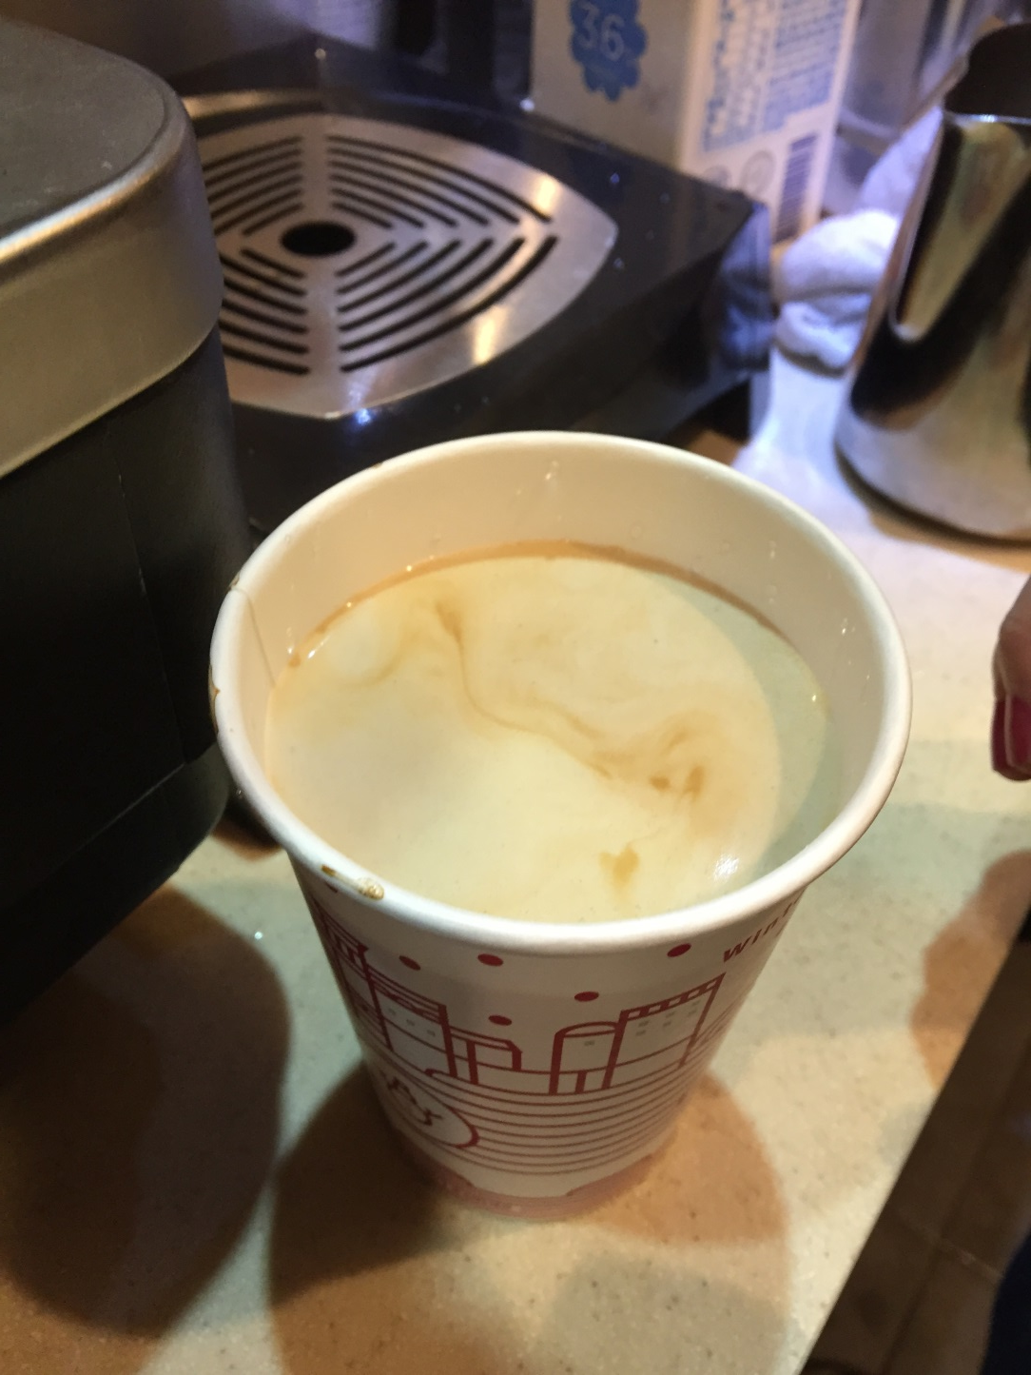
Complete !

Slide 12
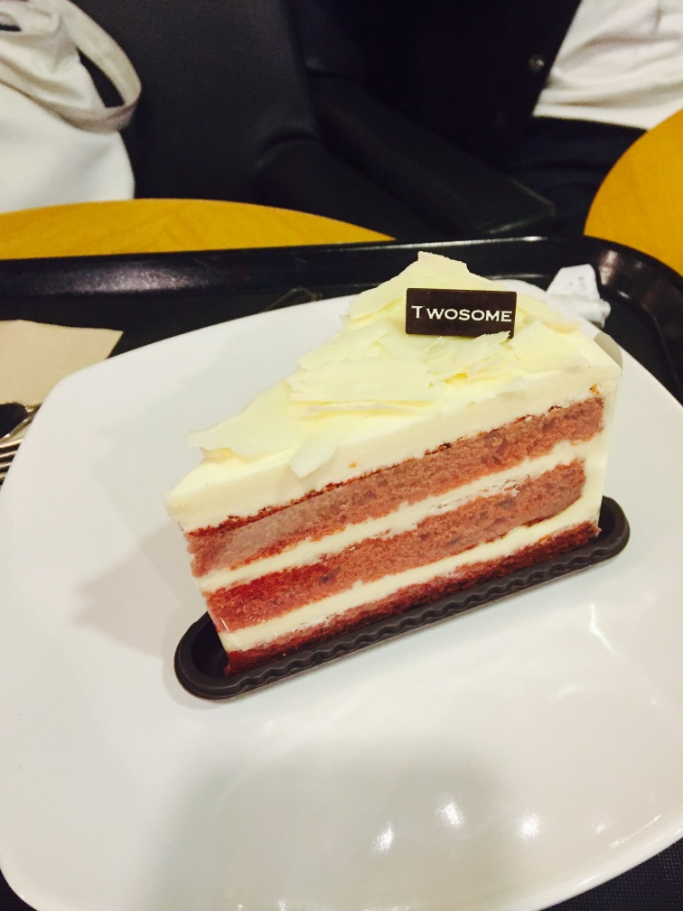
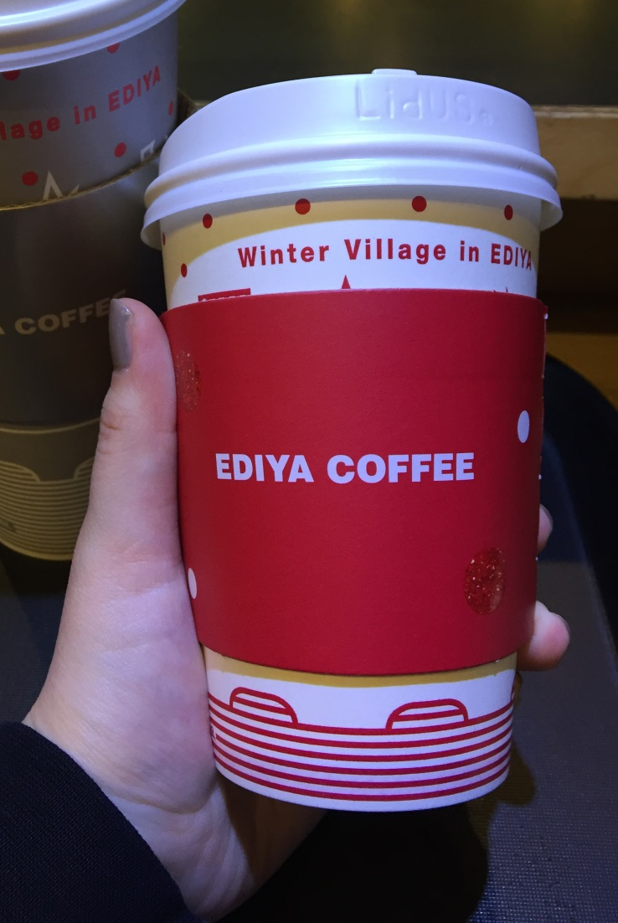
Tip : Enjoy coffee time !
Drink it with your favorite snack !

Slide 13
